Slide 1
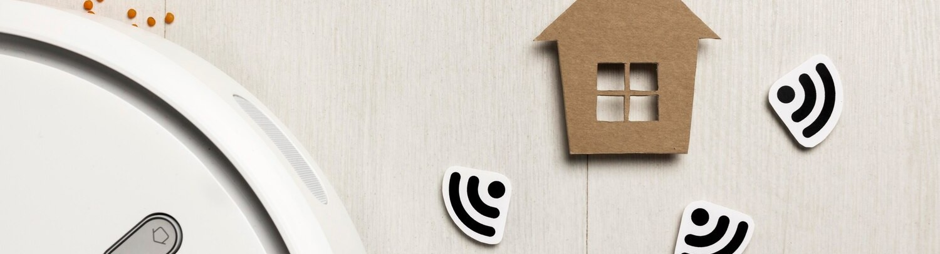
Revolutionizing Home Security:
Smart Wi-Fi Door Lock with ESP32-CAM & Telegram App

Slide 2
Introduction
Welcome to the presentation on Revolutionizing Home Security with Smart WiFi Door Lock using ESP32-CAM & Telegram App. This IoT project will showcase the latest advancements in home security technology. Join us to explore the future of home protection.

Slide 3
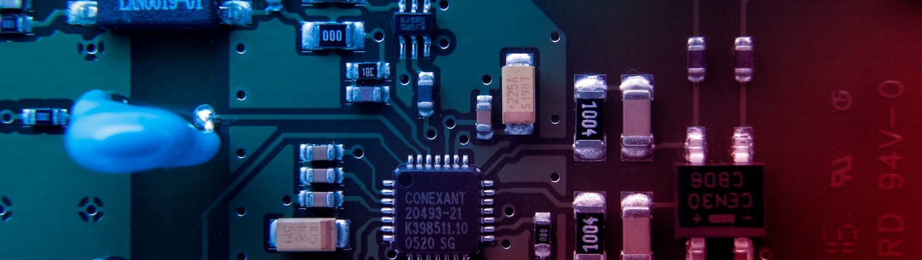
Smart WiFi Door Lock
The Smart WiFi Door Lock integrates the powerful ESP32-CAM microcontroller and a secure Telegram App interface. This innovative system enables remote access control and real- time monitoring of home security. Experience the ultimate convenience and peace of mind with this cutting-edge technology.

Slide 4
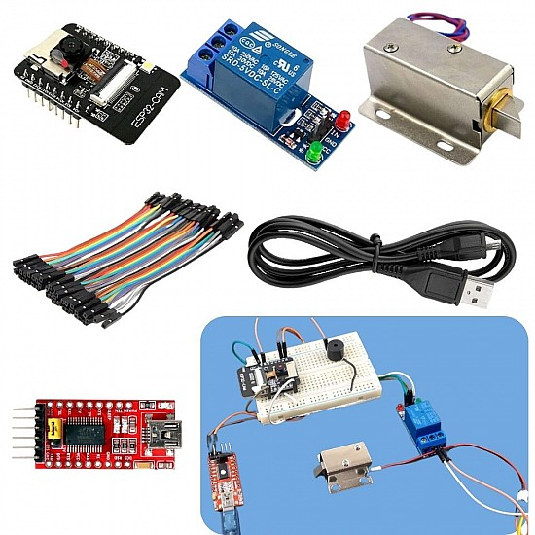
Required Components for the ESP32 CAM project
ESP32-CAM board
12V Electronic Lock
TIP122 NPN Transistor
7805 5V regulator
1N4007 diode
1k 0.25-watt Resistor
10k 0.25-watt Resistor
100uF 25V DC Capacitor
Push Switch
12V DC supply

Slide 5
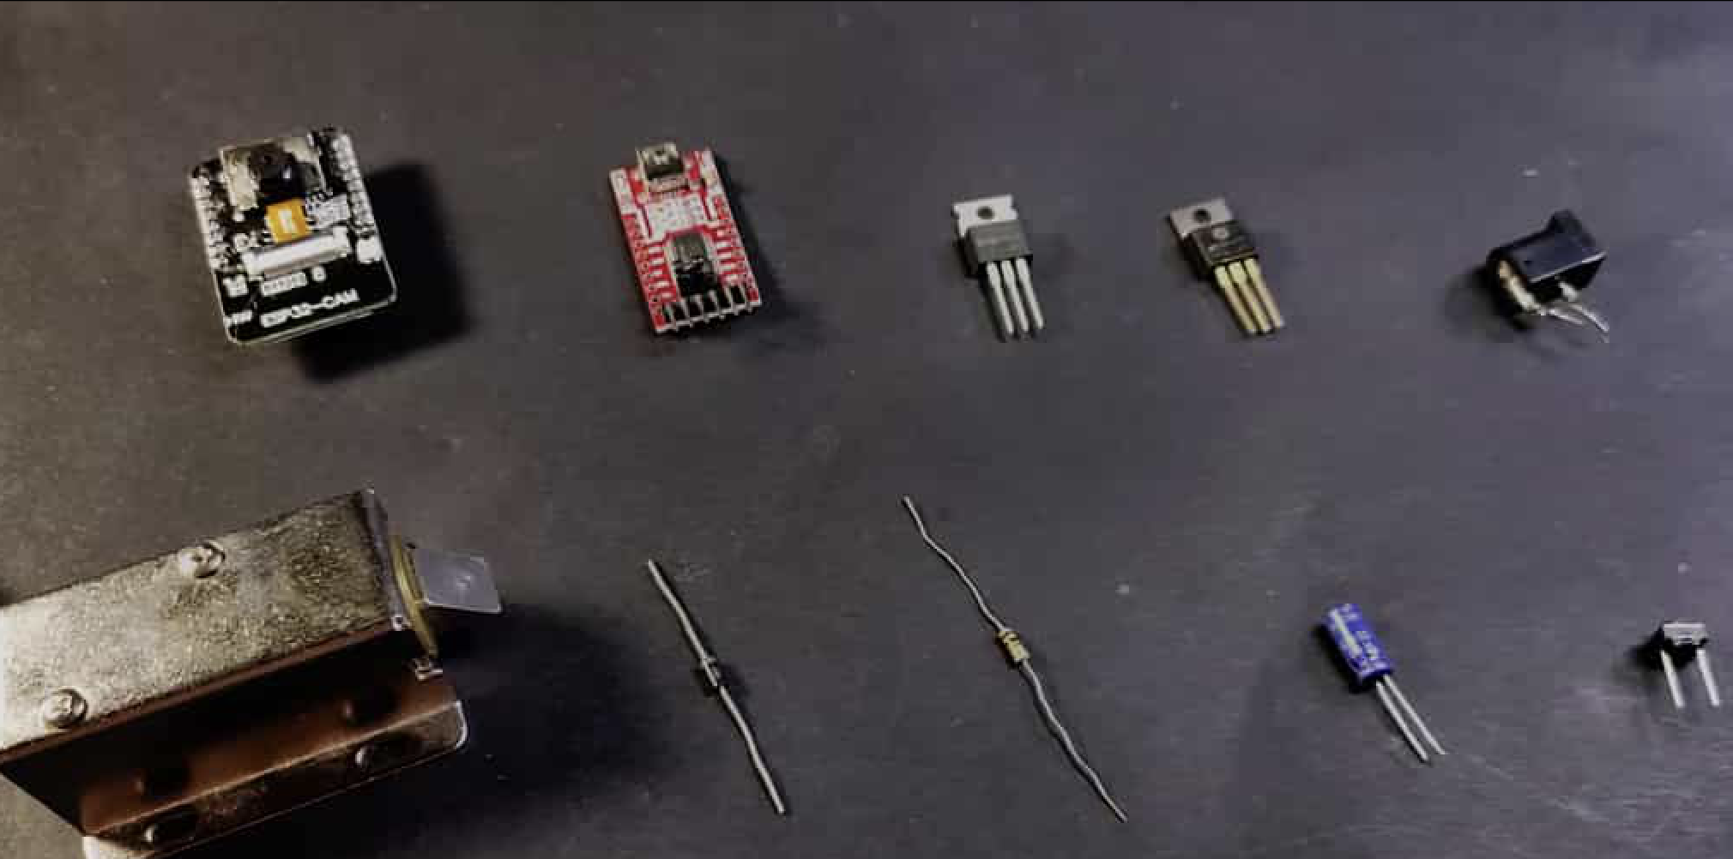
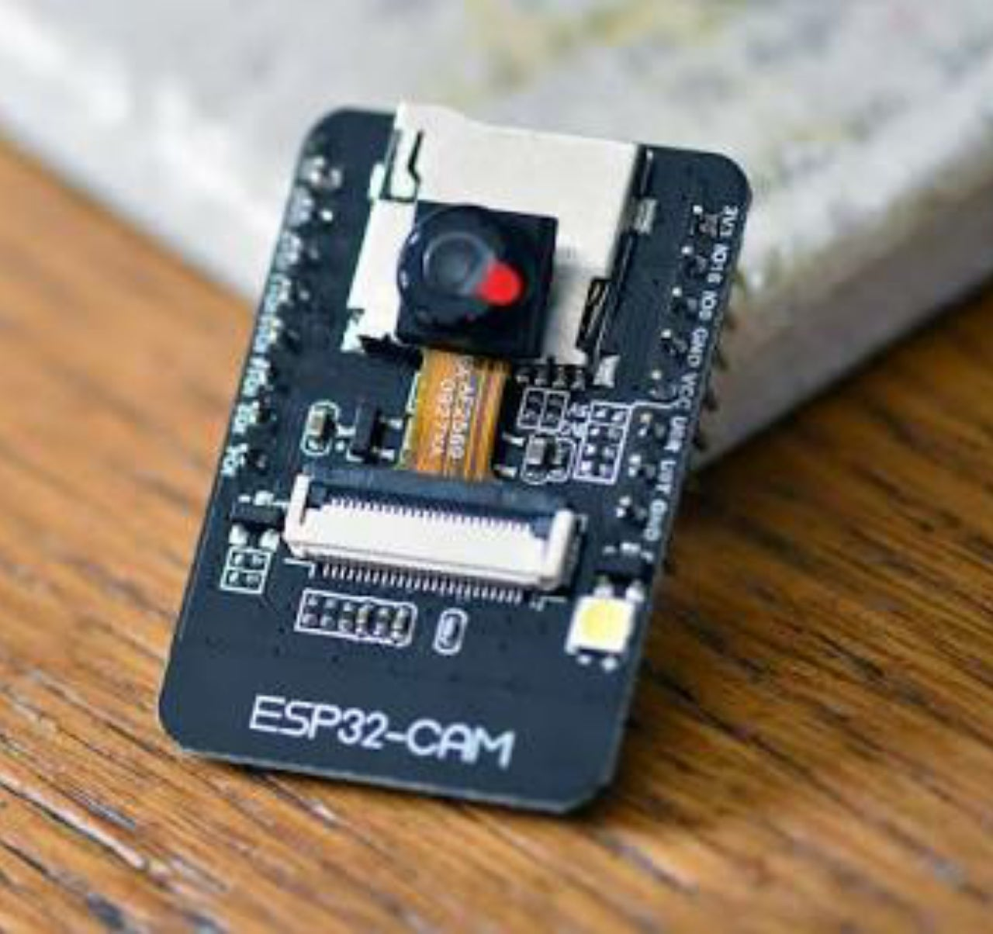
ESP32-CAM Technology
The ESP32-CAM module combines the power of the ESP32 microcontroller and a high-resolution camera. This advanced technology enables seamless connectivity and efﬁcient video streaming for real-time surveillance. Experience the next level of home security with the ESP32-CAM.

Slide 6
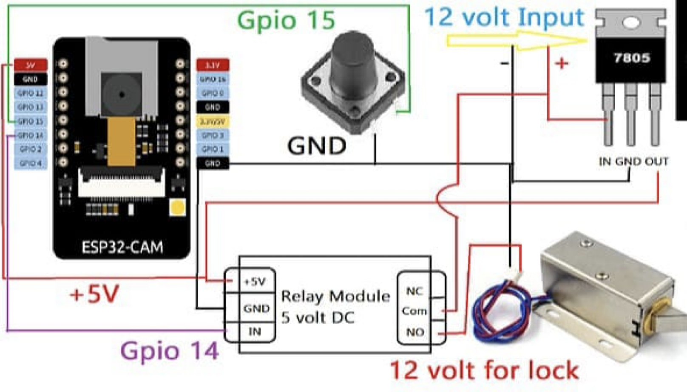
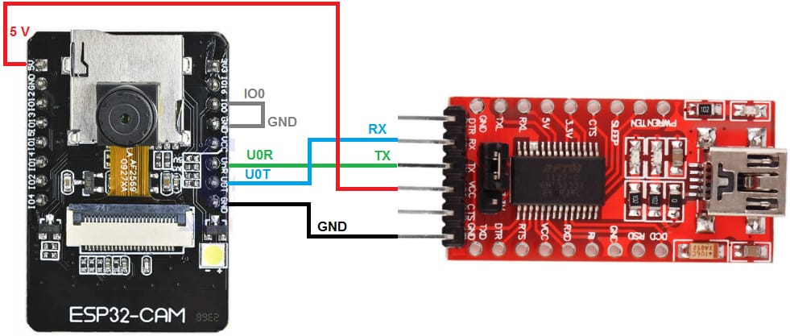
ESP32 CAM Wi-Fi lock circuit :

Slide 7

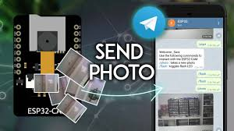
Telegram App Integration
The integration of the Telegram App provides a secure and user-friendly interface for controlling the smart door lock. With Telegram, users can receive instant notiﬁcations, remotely lock or unlock the door, and even view live video feeds. Stay connected and in control of your home security.

Slide 8

IoT Projects Impact
The implementation of this IoT project demonstrates the signiﬁcant impact of technology on home security. With the convergence of WiFi connectivity, microcontrollers, and mobile apps, homeowners can achieve unprecedented levels of security and convenience. Explore the potential of IoT in redeﬁning home protection.

Slide 9
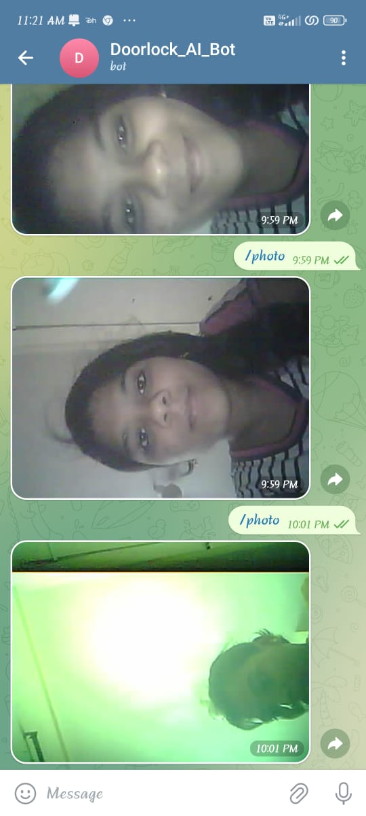
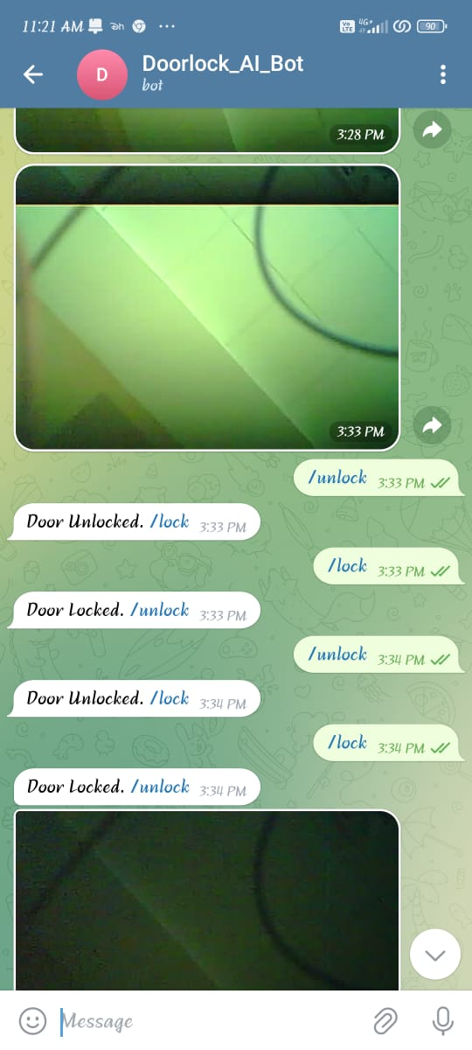
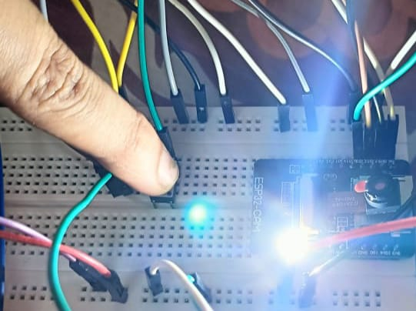
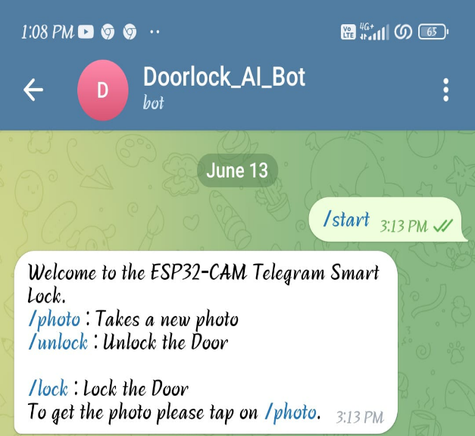
Results :
- Press the pushbutton, the ESP32CAM will capture the photo and send it to telegram app.
- if you tap on the /photo, then ESP32CAM will again take the photo and send it to telegram app.
- When the button is clicked, the ESP32-CAM sends a photo of the person in Telegram app. If unlock button is pressed, the door unlocks. If the lock button is pressed, the door locks.

Slide 10
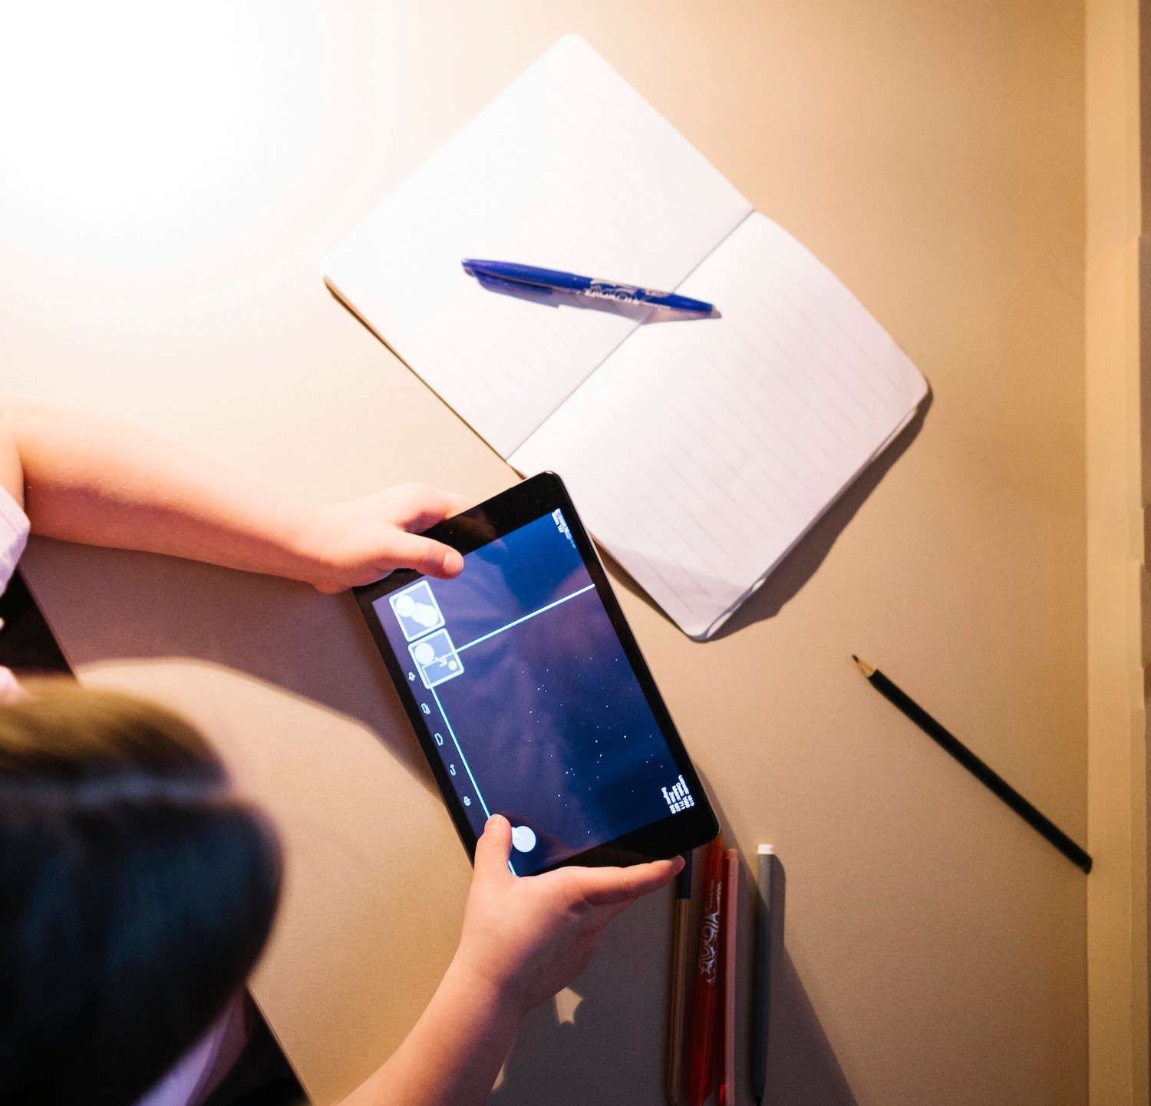
Conclusion
In conclusion, the Smart WiFi Door Lock with ESP32-CAM & Telegram App represents a remarkable advancement in home security. This innovative solution offers a blend of smart functionality and robust security features, setting a new standard for modern homes. Embrace the future of home security with this groundbreaking technology.

Slide 11
Thank You
By :- R.SAI SPANDANA
M.PRAVALLIKA
N.SIDDHARTHA

